Slide 1

Superstore sales analysis Project Performed In Mysql workbench
Data analysis By Sql (Project-1)

Slide 2

about the Data set
"Superstore Sales" generally refers to the sales data and performance of a superstore or a large retail store that offers a wide range of products and merchandise. These superstores are typically known for their extensive inventory, competitive pricing, and one-stop shopping experience.
Analyzing superstore sales data is essential for store owners, managers, and analysts to understand the store's performance, identify trends, and make informed business decisions. Here are some key aspects of superstore sales analysis.

Slide 3
Problem Statements
Analyzing Sales Performance by Region and Category.
1.Analyze sales performance by category across different regions.
2. Determine which category performs best in each region based on total sales and profit.
Customer Purchase Patterns Over Time:
3. Identify repeat customers and calculate the average time between their purchases.
4. Evaluate how often customers return to place new orders and find customers with increasing order frequency over time.
Ranking Products by Popularity and Profit
5.Rank products within each category based on sales volume and profitability.
6. Find the top 3 best-selling products in each category.

Slide 4
Problem Statements
Year-over-Year Sales Growth:
7. Calculate the year-over-year growth in sales and profit at a regional level.
Order Shipping Efficiency:
8.Calculate shipping duration for each order.
9.Compute the average shipping time by shipping mode and identify delayed shipments compared to the average.
Top Customers by Lifetime Value:
10. Calculate customer lifetime value (total sales per customer) and rank them accordingly.
11.Identify the top 10% of customers who contribute the most to the business.

Slide 5
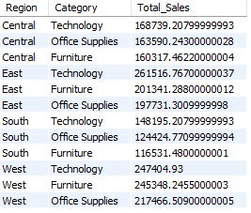
Analyzing Sales Performance by Region and Category
1.Analyze sales performance by category across different regions.
SELECT
Region,
Category,
SUM(Sales) AS Total_Sales FROM superstore
GROUP BY Region, Category
ORDER BY Region, Total_Sales DESC;

Slide 6
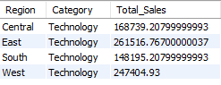
Analyzing Sales Performance by Region and Category
2. Determine which category performs best in each region based on total sales and profit .
WITH RegionCategorySales AS (
SELECT
Region,
Category,
SUM(Sales) AS Total_Sales
FROM superstore
GROUP BY Region, Category
),
RankedSales AS (
SELECT *,
RANK() OVER (PARTITION BY Region ORDER BY Total_Sales DESC) AS Sales_Rank FROM RegionCategorySales
)
SELECT Region, Category, Total_Sales FROM RankedSales
WHERE Sales_Rank = 1;

Slide 7
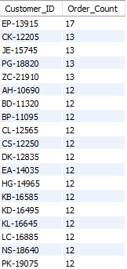
Customer Purchase Patterns Over Time
3.Identify repeat customers and calculate the average time between their purchases.
WITH CustomerOrders AS (
SELECT Customer_ID,
COUNT(DISTINCT Order_ID) AS Order_Count
FROM superstore
GROUP BY Customer_ID
)
SELECT * FROM CustomerOrders
WHERE Order_Count > 1
ORDER BY Order_Count DESC;

Slide 8
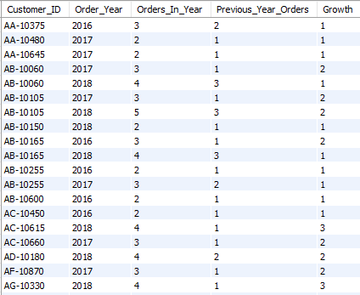
Customer Purchase Patterns Over Time
4. Evaluate how often customers return to place new orders and find customers with increasing order frequency over time.
WITH CustomerYearlyOrders AS (
SELECT Customer_ID, YEAR(STR_TO_DATE(Order_Date, '%d/%m/%Y’)) AS Order_Year,
COUNT(DISTINCT Order_ID) AS Orders_In_Year
FROM superstore
GROUP BY Customer_ID, Order_Year),
countCustomerGrowth AS (
SELECT Customer_ID, Order_Year, Orders_In_Year,
LAG(Orders_In_Year) OVER (PARTITION BY Customer_ID ORDER BY Order_Year) AS Previous_Year_Orders
FROM CustomerYearlyOrders
SELECT Customer_ID, Order_Year, Orders_In_Year, Previous_Year_Orders,
(Orders_In_Year - Previous_Year_Orders) AS Growth
FROM CustomerGrowth
WHERE Previous_Year_Orders IS NOT NULL AND Orders_In_Year > Previous_Year_Orders
ORDER BY Customer_ID, Order_Year;

Slide 9
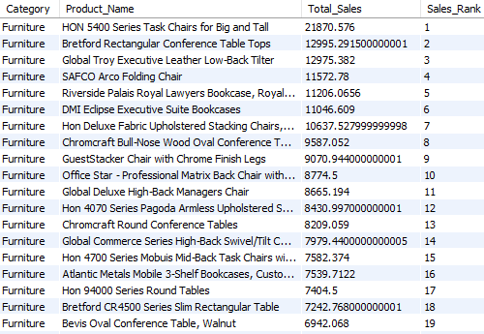
Ranking Products by Popularity and Profit
5.Rank products within each category based on sales volume and profitability.
SELECT Category, Product_Name, SUM(Sales) AS Total_Sales,
RANK() OVER (PARTITION BY Category
ORDER BY SUM(Sales) DESC) AS Sales_Rank
FROM superstore
GROUP BY Category, Product_Name
ORDER BY Category, Sales_Rank;

Slide 10
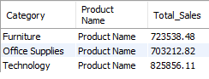
Ranking Products by Popularity and Profit
6.Find the top 3 best-selling products in each category.
WITH ProductSales AS (
SELECT Category, "Product Name",
ROUND(SUM(Sales),2) AS Total_Sales
FROM Superstore GROUP BY Category, "Product Name"),
RankedSales AS (
SELECT *,
RANK() OVER (PARTITION BY Category ORDER BY Total_Sales DESC) AS Sales_Rank
FROM ProductSales
)
SELECT Category, "Product Name", Total_Sales
FROM RankedSales
WHERE Sales_Rank <= 3
ORDER BY Category, Sales_Rank;

Slide 11
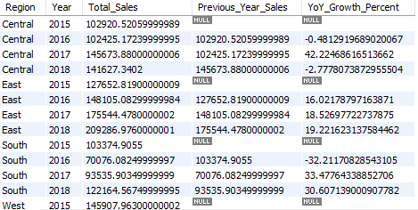
Year-over-Year Sales Growth
7.calculate the year-over-year growth in sales and profit at a regional level.
WITH YearlySales AS (
SELECT Region, YEAR(STR_TO_DATE(Order_Date, '%d/%m/%Y')) AS Year,
SUM(Sales) AS Total_Sales
FROM superstore
GROUP BY Region, Year),
SalesGrowth AS (
SELECT *,
LAG(Total_Sales) OVER (PARTITION BY Region ORDER BY Year)
AS Previous_Year_Sales,
(Total_Sales - LAG(Total_Sales)
OVER (PARTITION BY Region ORDER BY Year)) * 100.0 / LAG(Total_Sales)
OVER (PARTITION BY Region ORDER BY Year) AS YoY_Growth_Percent
FROM YearlySales
)
SELECT * FROM SalesGrowth;

Slide 12
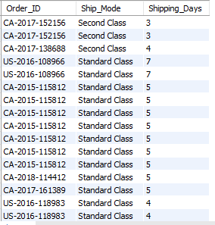
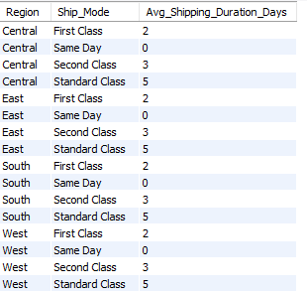
Order Shipping Efficiency
8.Calculate shipping duration for each order.
SELECT Order_ID, Ship_Mode,
DATEDIFF(STR_TO_DATE(Ship_Date, '%d/%m/%Y’),
STR_TO_DATE(Order_Date, '%d/%m/%Y')) AS Shipping_Days
FROM superstore;
Average Shipping Days:
SELECT Region, Ship_Mode,
ROUND(AVG(DATEDIFF(STR_TO_DATE(Ship_Date, '%d/%m/%Y'), STR_TO_DATE(Order_Date, '%d/%m/%Y'))))
AS Avg_Shipping_Duration_Days
FROM Superstore
GROUP BY Region, Ship_Mode
ORDER BY Region, Ship_Mode;

Slide 13
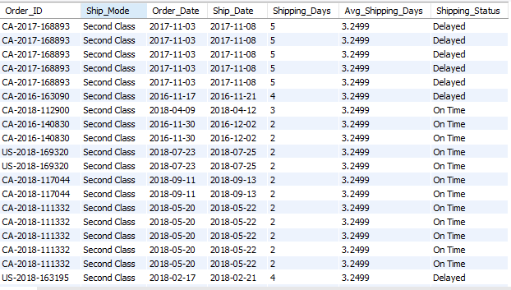
Order Shipping Efficiency
9.Compute the average shipping time by shipping mode and identify delayed shipments compared to the average.
WITH AvgShipping AS (
SELECT Ship_Mode, AVG(DATEDIFF(STR_TO_DATE(Ship_Date, '%d/%m/%Y'), STR_TO_DATE(Order_Date, '%d/%m/%Y')))
AS Avg_Shipping_Days
FROM superstore
GROUP BY Ship_Mode)
SELECT s.Order_ID, s.Ship_Mode,
STR_TO_DATE(s.Order_Date, '%d/%m/%Y') AS Order_Date, STR_TO_DATE(s.Ship_Date, '%d/%m/%Y') AS Ship_Date,
DATEDIFF(STR_TO_DATE(s.Ship_Date, '%d/%m/%Y’),
STR_TO_DATE(s.Order_Date, '%d/%m/%Y')) AS Shipping_Days, a.Avg_Shipping_Days,
a.Avg_Shipping_Days,
CASE
WHEN
DATEDIFF(STR_TO_DATE(s.Ship_Date, '%d/%m/%Y'), STR_TO_DATE(s.Order_Date, '%d/%m/%Y')) > a.Avg_Shipping_Days
THEN 'Delayed'
ELSE 'On Time'
END AS Shipping_StatusFROM superstore s
JOIN AvgShipping a ON s.Ship_Mode = a.Ship_Mode;

Slide 14
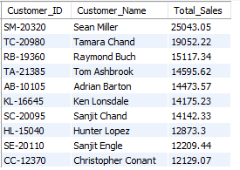
Customers by Lifetime Value
10.Identify the top 10% of customers who contribute the most to the business.
SELECT
Customer_ID, Customer_Name,
ROUND(SUM(Sales),2) AS Total_Sales
FROM superstore
GROUP BY Customer_ID, Customer_Name
ORDER BY Total_Sales DESC
LIMIT 10;

Slide 15
Customers by Lifetime Value
10.Identify the top 10 of customers who contribute the most to the business.
Top 10 Customers by Total Sales:
SELECT
Customer_ID, Customer_Name,
ROUND(SUM(Sales),2) AS Total_Sales
FROM superstore
GROUP BY Customer_ID, Customer_Name
ORDER BY Total_Sales DESC
LIMIT 10;

Slide 16
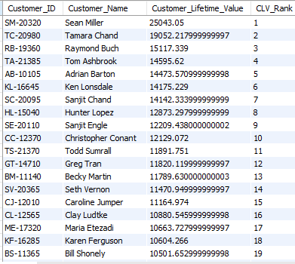
Customers by Lifetime Value
11. Calculate customer lifetime value (total sales per customer) and rank them accordingly.
WITH CustomerSales AS (
SELECT Customer_ID, Customer_Name, SUM(Sales) AS Customer_Lifetime_Value
FROM Superstore
GROUP BY Customer_ID, Customer_Name),
RankedCLV AS (
SELECT *,
RANK() OVER (ORDER BY Customer_Lifetime_Value DESC) AS CLV_Rank
FROM CustomerSales
)
SELECT Customer_ID, Customer_Name, Customer_Lifetime_Value, CLV_Rank
FROM RankedCLV
ORDER BY CLV_Rank;

Slide 17
thank you

